Slide 1
Chloroplastic photorespiratory bypass increases photosynthesis and biomass production in Arabidopsis thaliana
Rashad Kebeish, Markus Niessen, Krishnaveni Thiruveedhi, Rafijul Bari, Heinz-Josef Hirsch,
Ruben Rosenkranz, Norma Stäbler, Barbara Schönfeld, Fritz Kreuzaler & Christoph Peterhänsel

Slide 2
Introduction
Many important crops are C₃ plants
CO₂ fixation catalysed by rubisco*
Rubisco is particularly inefficient
*ribulose-1,5-bisphosphate carboxylase/ oxygenase

Slide 3
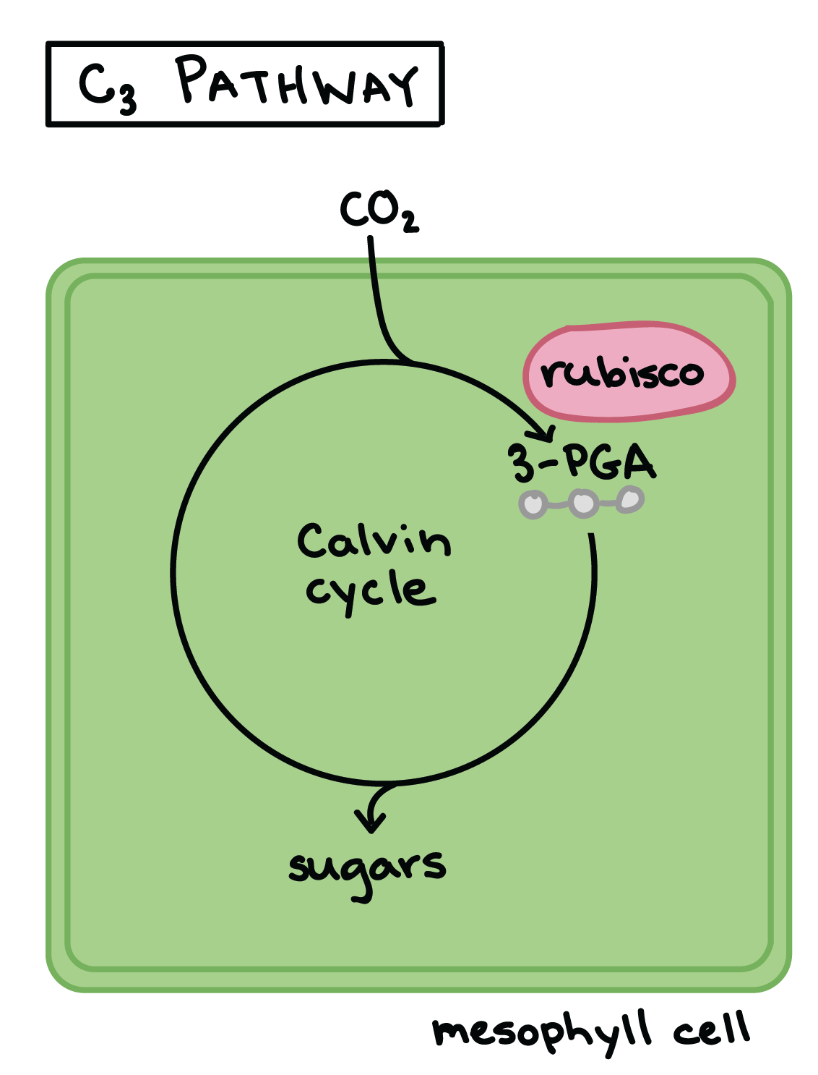
C₃ plants
Similarity: same metabolic pathway for carbon fixation in photosynthesis
Examples: rice , wheat , barley , soybean, peanut, cotton, tobacco, spinach, potato
https://www.khanacademy.org/science/biology/photosynthesis-in-plants/photorespiration--c3-c4-cam-plants/a/c3-c4-and-cam-plants-agriculture
Source: http://www.cropsreview.com/c3-plants.html

Slide 4
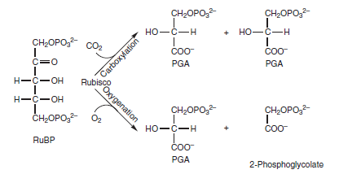
Rubisco
Can catalyze two reactions:
→ carboxylation of ribulose-1,5-bisphosphate
product: two phosphoglycerate (→ Calvin cycle)
→ oxygenation of ribulose-1,5-bisphosphate
product: phosphoglycerate and phosphoglycolate
Balance between both activities depends on O₂/CO₂ ratio in leaves
http://i18.servimg.com/u/f18/17/30/76/23/yuiyui13.png

Slide 5
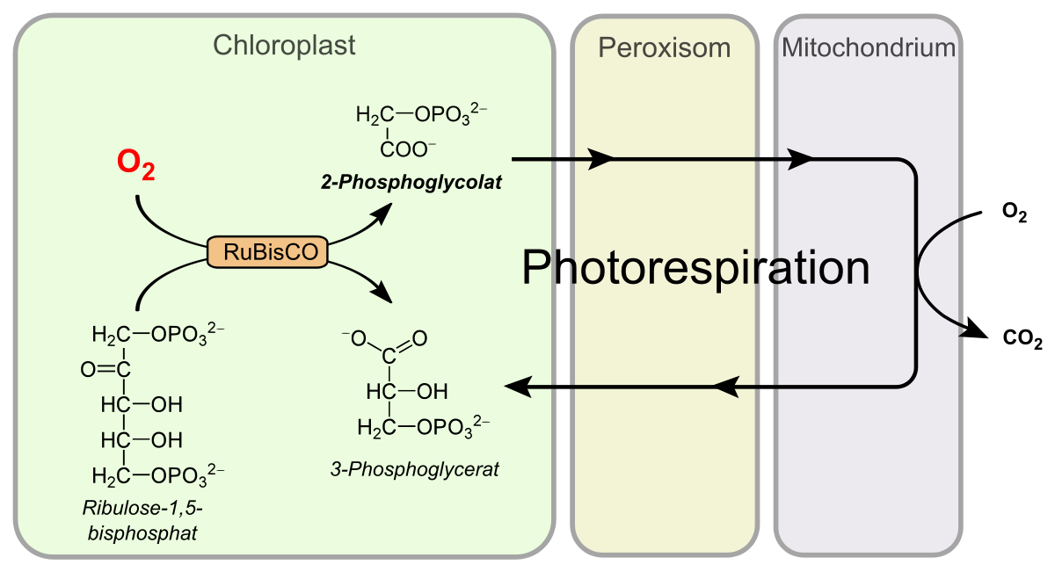
Phosphoglycolate
Recycled into phosphoglycerate by photorespiration
Ammonia is also lost in the reaction and needs to be refixed under energy consumption

Slide 6
Improvement opportunities
Doubling of CO₂ concentration (in glasshouse environment)
→ increasing performance
→ not possible in the field
Photorespiratory bypass
→ effects studied in this paper

Slide 7
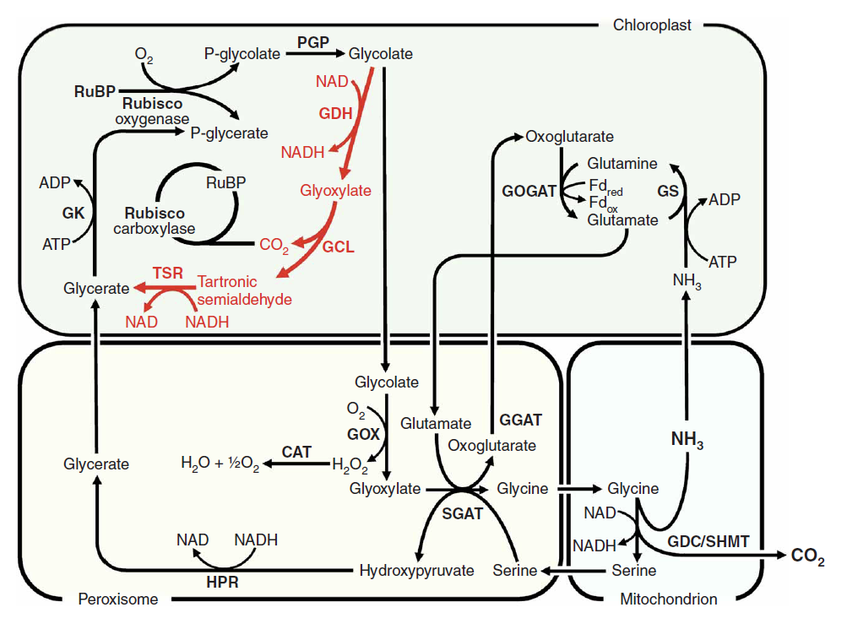
Photorespiratory bypass
E. coli glycolate pathway (shown in red)
3 enzymes:
→ glycolate dehydrogenase (GDH)
→ glyoxylate carboxyligase (GCL)
→ tartronic semialdehyde reductase (TSR)
GDH has three subunits
→ D, E, F
http://www.esalq.usp.br/lepse/imgs/conteudo_thumb/Chloroplastic-photorespiratory-bypass-increases-photosynthesis-and-biomass-production-in-Arabidopsis-thaliana.pdf

Slide 8
Results

Slide 9
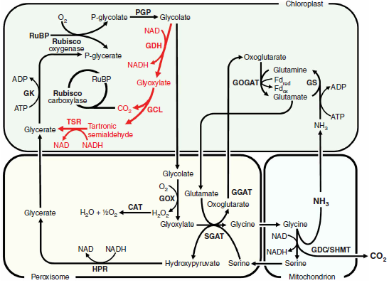
Glyoxylate pathway

Slide 10
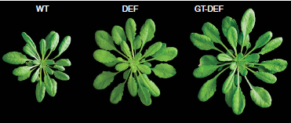
Enhanced biomass production in DEF and GT-DEF plants

Slide 11
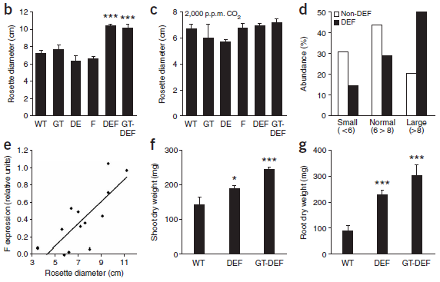
Enhanced biomass production in DEF and GT-DEF plants

Slide 12
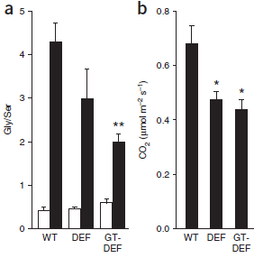
Reduced photorespiration in DEF and GT-DEF plants

Slide 13
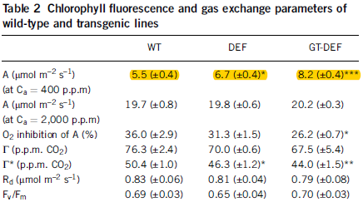
Improved photosynthetic performance of DEF and GT-DEF plants
CO2 assimilation enhanced in DEF and GT-DEF plants
Maximum assimilation at 2000 p.p.m. was not affected

Slide 14
Methods

Slide 15
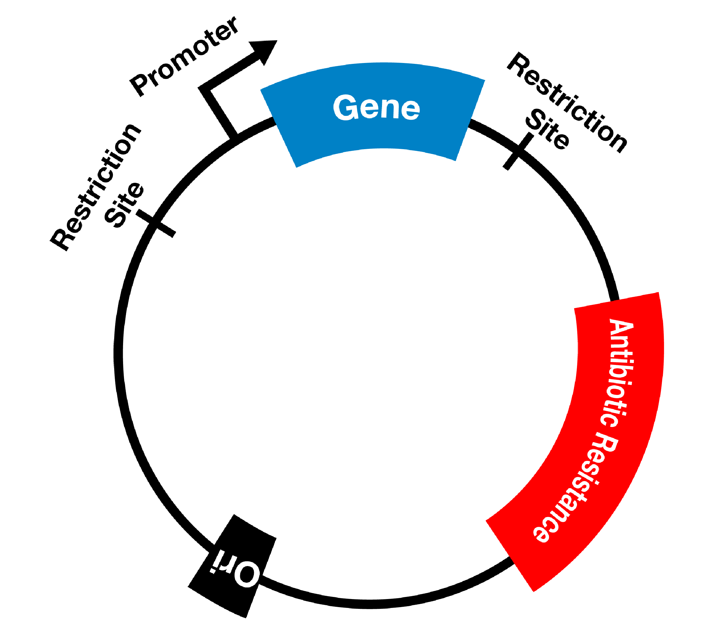
Plasmide construction
Amplification of GLC and TSR through PCR
Cloning into the plant expression vector

Slide 16
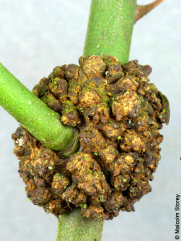
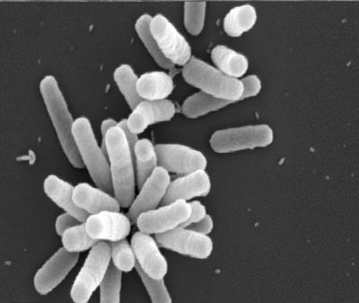
Plant growth and transformation
Transformation of A. thaliana by Agrobacterium tumefaciens.
Growth conditions: -Short day conditions (8h, 16h) -Temperature: 22°C -Light emission: 100 µmol/m^-2*s^-1
CO2 treatments 100 ppm and 2000 ppm

Slide 17
Chloroplast isolation
Isolation: 4 weeks old A. thaliana plants.
Preparation: -Plant material: 5g leaf -50mL grinding buffer -Centrifugation: 1000g for 10min -Resuspension -Centrifugation: 500g for 5 min -Washed

Slide 18
CO2 release from labeled glycolate in chloroplast extracts
Mix of 1µCi [1,2-14C] and 50 µg of chloroplast protein
Absorption of CO2 - 0.5mL tube, containing 0.5M NaOH

Slide 19
Determination of metabolites and chlorophyll contents
Preparation: Freezing of two samples after 4h of illumination
Extraction of sugars with boiling ethanol
Starch determination: - Enzymatic hyrolization
AA determination: → Glycine and Serine - Whole leafs were harvested - Amount of AA was determined with gas chromatographie and MS.

Slide 20
Statistical analysis
Significance determination → Student’s t-test
Tool: Excel (Microsoft)

Slide 21
Summary (Rubisco)
CO2 is fixated by Rubisco
Rubisco catalyzes both oxygenation and carboxylation of ribulose-1,5-bisphosphate
Carboxylation → 2 phosphoglycerate → calvin cycle (photosynthesis)
Oxygenation → phosphoglycerate and phosphoglycolate → phosphoglycolate recycled through photorespiration
balance between both activities depends on O₂/CO₂ ratio in leaves

Slide 22
Summary (Photorespiration)
Negative impact on plant growth
Recovery of carbon from phosphoglycolate
Removal of inhibitors of photosynthesis
Photorespiration mutants cannot grow at ambient CO2 concentration

Slide 23
Summary(Methods)
Creation of pathway requires three plasmid
One encodes both GDH subunits D and E
One encodes subunit F of GDH
One encodes both GCL and TSR
Experiments were conducted with 3 kinds of plants. WT-, DEF- and GT-DEF-plants.

Slide 24
Summary (Bypass)
Reduction of photorespiratory losses by this catabolic pathway
Gly/Ser ratio
Increased by a factor of 10 for WT
PIB as indicator of CO2 release
~30% compared to the wild type
Enhanced CO2 release from glycolate in chloroplast extracts
Improved photosynthetic performance
More biomass production in DEF and GT-DEF plants
Notes:
Step-wise nuclear transformation and targeting
No homozygous lines

